Slide 1
Employee Data Analysis
using Excel
STUDENT NAME: Akshyaa.J
REGISTER NO:312209746
NM ID:872ADC2A074B23296B7493D02D9DF833
DEPARTMENT: Bcom Computer Application
COLLEGE : Anna Adarsh College For Women

Slide 2
PROJECT TITLE
Employee Salary Analysis using Excel

Slide 3
AGENDA
Problem Statement
Project Overview
End Users
Our Solution and Proposition
Dataset Description
Modelling Approach
Results and Discussion
Conclusion

Slide 4
PROBLEM ST ATEMENT
WHY ARE WE ANALYSING SALARY OF AN EMPLOYEE?
FAIR COMPENSATION: Ensuring employees are paid fairly and equitably based on their
role and experience.
PERFORMANCE EVALUATION: Relate salary to performance ,promoting merit based rewards
which increases productivity and overall development of both
the employee and the organisation.

Slide 5
PROJECT OVERVIEW
Employee Salary Analysis is analysing the salary of every employee.
Based on Gender, Employment Type like whether the employee is working on
Permanently or Fixed term or Temporary and according to that salary will be issued in
Levels/Grade.
Salary will differ from employee to employee based on their Employment type.
This is done to systematically analyse employee salary across the organisation
identifying key factors and develop strategies to improve overall produvtivity
and job satisfaction.

Slide 6
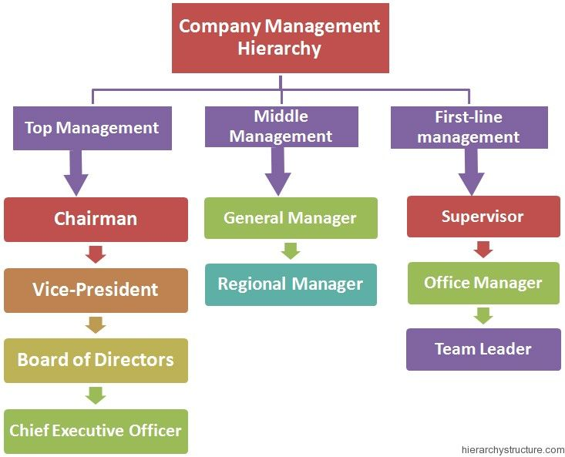
WHO ARE THE END USERS?
People who get benifited by doing Employee salary analysis in an organisation:

Slide 7
OUR SOLUTION AND ITS VALUE PROPOSITION
Conditional Formatting: To find out the missing values in the Excel.
Filter option: To remove all the blank fields in the excel.
Pivot table: To summarise the values according to our analysis.
Graph: To visualise the data that we have analysed used the pivot table.
Chart elements: To add chart title and to format trendline in the graph.

Slide 8
Dataset Description
Employee Data set - Downloaded from Kaggle
Features - 26 features.
Used - 5 features.
Name- Name of the employee in text.
Employee Type - The type of employment the employee
has i.e., Fixed term, Permanent, Temporary
Gender code- A code representing the gender of the
employee, M-Male, F-Female.
Department- The department in which the employee
is working.
Salary Grade- Converting Salary values to text like
Platinum , Diamond ,Gold , Silver.

Slide 9
THE "WOW" IN OUR SOLUTION
To covert salary values to Text for graph formation, Formulae was used :
Formulae:
=IFS(J2>=100000,"PLATINUM",J2>=50000,"DIAMOND",J2>=30000,"GOLD",TRUE,"SILVER")

Slide 10
MODELLING
Data Collection: Data downloaded from Kaggle and Edunet dashboard.
Feature collection: Totally 26 features was there in the dataset. Out of that I chose
the features that was needed for my analysis.Like Salary,Salary grade,
Employee type,Department,Gender,Name.
Data Cleaning: Found out the missing values(Blanks) and filtered it out
Salary Grade: Salary values was given in numbers, so to change it to text for graph , used
formulae to change the numbers into text like Platinum,Gold,Diamon,Silver.
Summary: Used Pivot table to summarise all the values by dragging items to ROWS category,
COLOUMN category, VALUES category and FILTER category.
Visualisation: Used graph to visualise the analysis that we have formulated.
chose the recommended Pivot chart , added chart title to the graph.
Got result for every employee type.Used Slicer option to add department
feature to the Pivot table.

Slide 11
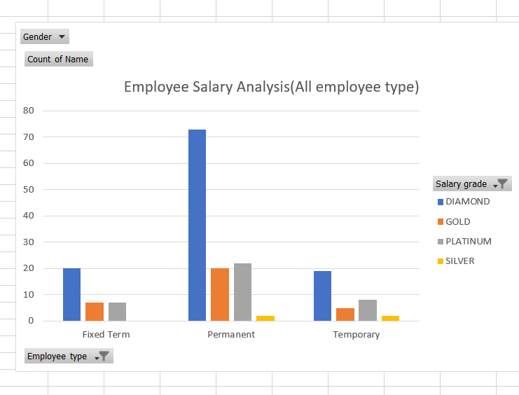
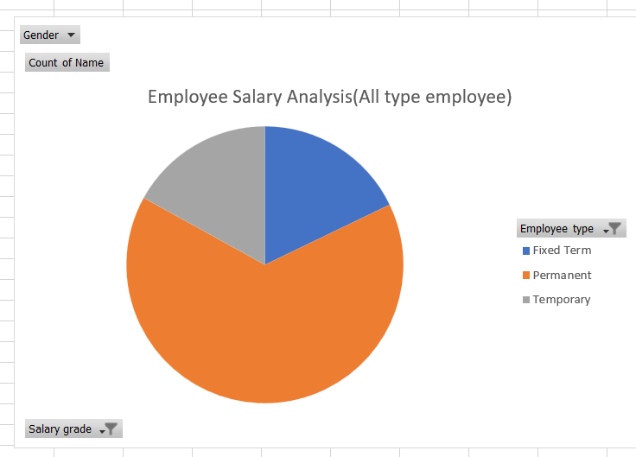
RESULT(All Employee Type)

Slide 12
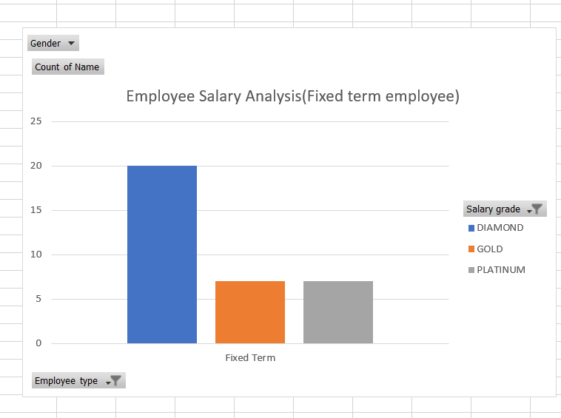
RESULT(Fixed term employees)

Slide 13
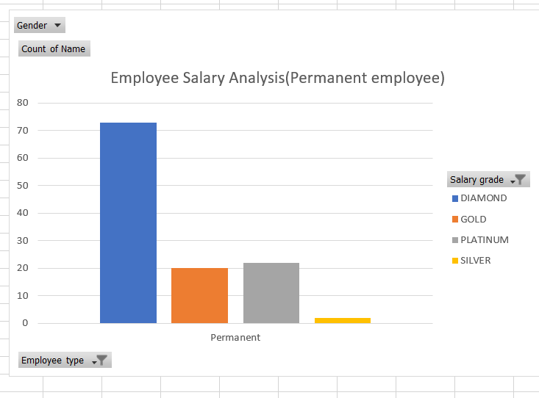
RESULT(Permanent employees)

Slide 14
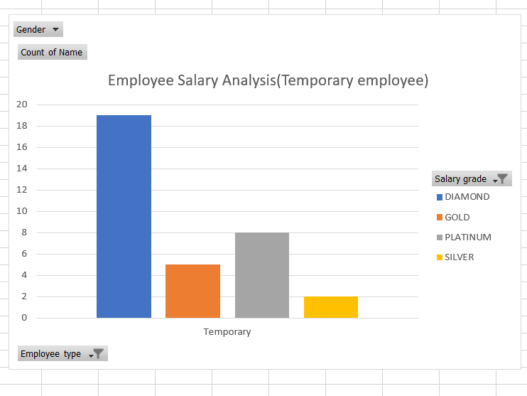
RESULT(Temporary employees)

Slide 15
Conclusion
By doing the Salary Analysis of Employee, can conclude that in this organisation
Salary is given to employees based on their Employee type and department they
Work in.
There are different grades of salary like PLATINUM,DIAMOND,GOLD,SILVER, which differentiates
the salary amount.
Platinum = Greater than or equal to 1,00,000
Diamond = Greater than or equal to 50,000
Gold = Greater than or equal to 30,000
Silver = Less than 30,000
By doing like this we can motivate other employess who are getting salary
in grade Gold and Silver to get salary in grade Platinum and Diamond.
This will make the employees work harder and can also make temporary employees to
Permant employees and Fixed term employees.
This is beneficial for Both the organisation and the Employees. As for the organisation
if all the employees start working efficiently the company’s growth level will become higher.
So its important to analyse the salary of the Employees in an company to gain Possitive outcome
in the organisation.

